Slide 1
Instructions for Use of These Slides
The purpose of these slides is to serve as a resource that any radiation oncologist can use when speaking about palliative radiation therapy.
The target audience could include residents/fellows, staff physicians or mid-level providers in the field of emergency medicine, internal medicine, palliative care and medical oncology. However, when speaking to medical oncology one may consider removing slides 5-20 since medical oncologists likely have greater knowledge of this content. Any user is welcome to format the slides as needed to fit their target audience.
Please ask attendees to complete either the pre-test or post-test so that we can assess the effectiveness of the slides. If you make significant changes to the content of the slides for your presentation, we prefer that you use the pre-test only.
Pre-test link: https://redcap.link/inpatients-pre
Post-test link: https://redcap.link/inpatients1
Primary Author(s): Malcolm Mattes
Peer Reviewer(s): Bailey Nelson, Gabriel Peters, Mike Corradetti, Shunqing Zhang, J. Ben Wilkinson, Elizabeth Loggers
Additional Support: ASTRO Communications Committee
Last updated in November 2025 – newer data may impact the accuracy of the content of these slides

Slide 2
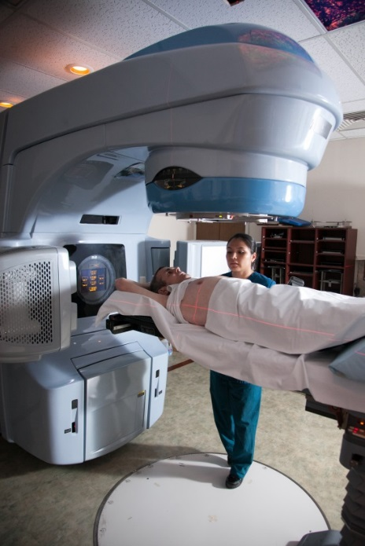

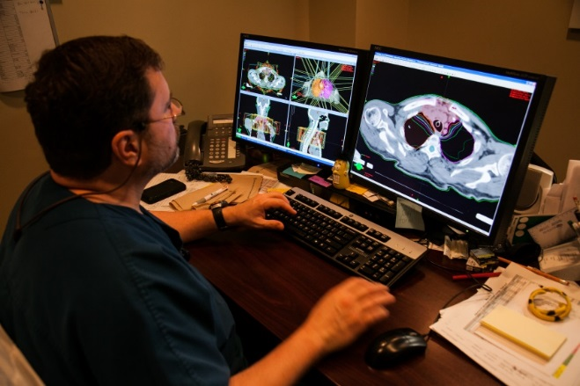
Integrating Radiation Therapy into Multidisciplinary Palliative Cancer Care

Slide 3
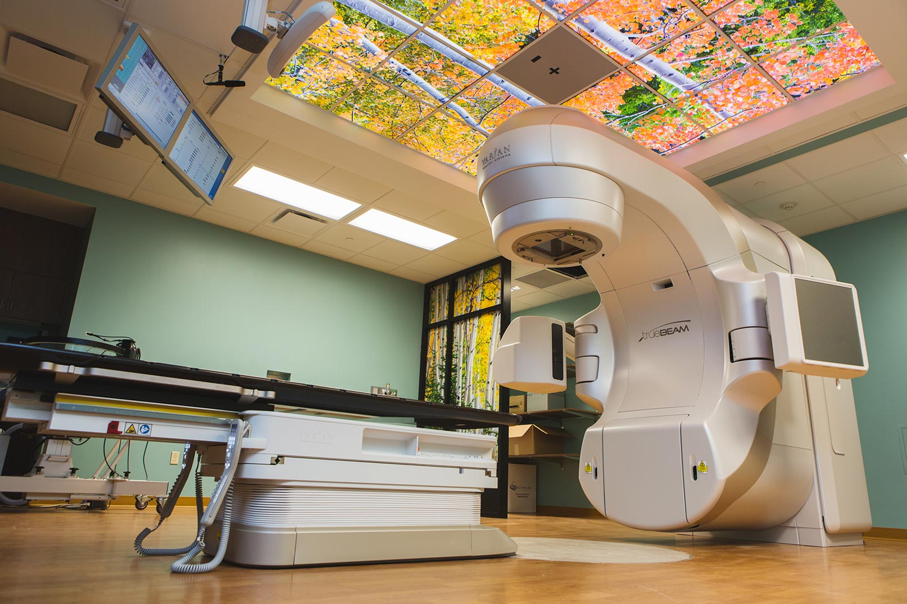
Learning Objectives
Understand the value of radiation therapy in cancer management
Review fundamental principles of palliative radiation therapy
Consider best practices for triaging inpatient referrals for palliative radiation therapy

Slide 4
What is the Value of Radiation Therapy in Multidisciplinary Cancer Care?

Slide 5
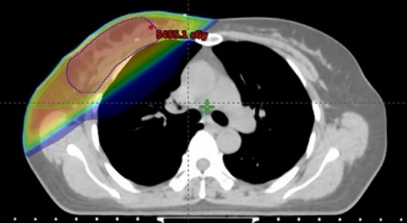
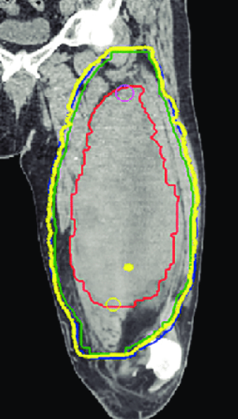
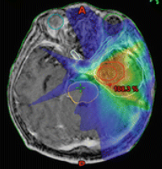
Curative Approaches Involving Surgery for Solid Tumors
Sometimes surgery is the primary curative modality
Pre-op or post-op radiation therapy is used to:
eradicate microscopic tumor cells in the area
enable a less extensive or morbid surgery
Examples:
breast cancer, soft tissue sarcomas, malignant gliomas

Slide 6
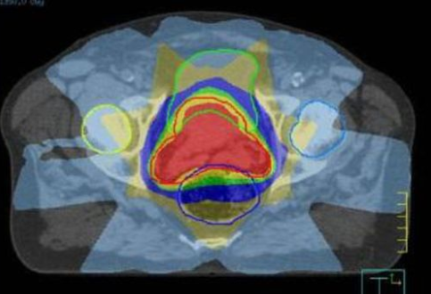
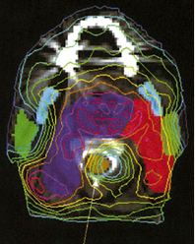
Curative Approaches Not Involving Surgery for Solid Tumors
Sometimes definitive radiation therapy is used instead of surgery with comparable probability of cure
Potential reasons include:
Not all tumors are surgically resectable
Not all patients are medically operable
Some cancer surgeries are very morbid & organ preservation is desirable
Examples:
Prostate, larynx, pharynx, bladder, anus, cervix, lung

Slide 7
Radiation Therapy for Metastatic Cancer
Systemic therapy is the main treatment to control tumor growth and potentially prolong life. However…
response rates are often low, and take weeks-months to occur
Palliative radiation can provide a greater likelihood of rapid symptom relief
e.g. pain, bleeding, neurologic symptoms, obstruction
If used appropriately, can prevent severe symptom crises¹
Consolidative radiation for patients with limited metastases
improve duration of response to supplement systemic therapy²
¹Gillespie et al., J Clin Oncol, 2024
²Palma et al. J Clin Oncol, 2020

Slide 8
Radiation is a Quality-of-Life Oriented Treatment Modality
Definitive RT
Quality-of-life benefits in both the curative and palliative settings
(Neo)Adjuvant RT
Palliative RT
Consolidative RT
Notes:
quality-of-life benefits that may not be possible with the other modalities

Slide 9
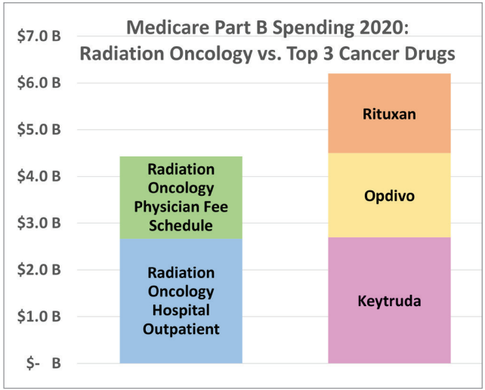
Radiation is Relatively Low Cost
There are approximately 150 FDA approved drugs for cancer
Medicare spends less on all of radiation oncology than it does on just three cancer drugs.

Slide 10
Fundamental Principles of Palliative Radiation Therapy

Slide 11
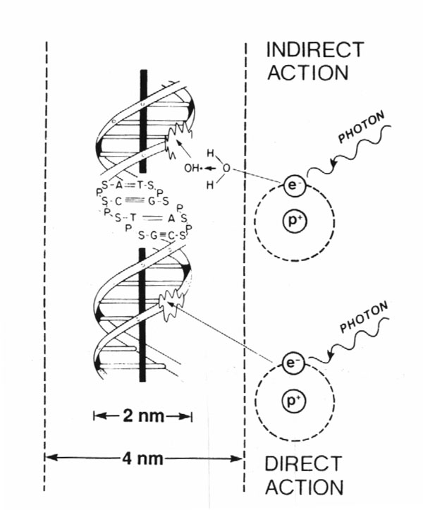
How Does Radiation Work?
80%
X-rays interact with water
radiolysis
free radicals
bind to and damage DNA
cell death
(by mitotic catastrophe)
20%
Cancer cells are usually more susceptible to RT due to impaired DNA repair pathways

Slide 12
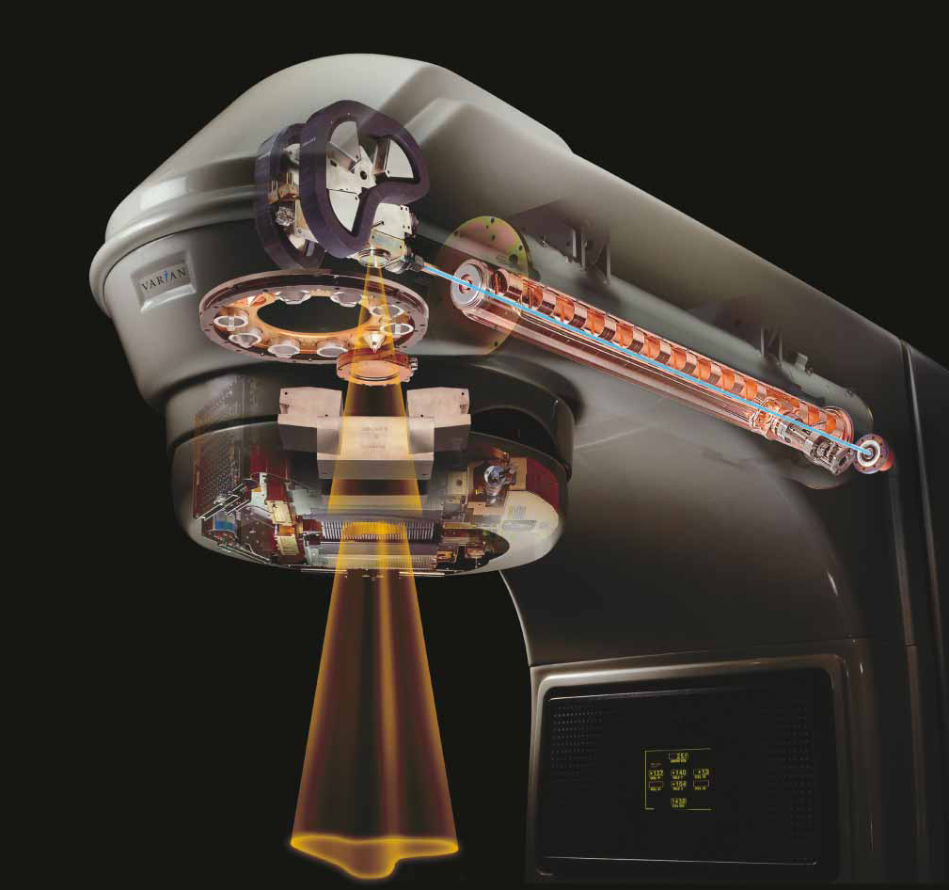
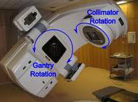

Linear Accelerator (Linac)
Delivers high energy X-rays (photons) or electrons
Non-invasive
Rapid treatment delivery, in minutes
Used to treat outpatients and inpatients

Slide 13
Evolution of External Beam Radiation Therapy
Radiation used to be delivered in a relatively imprecise way to a tumor and large portions of the normal tissue around it.
Advances in imaging, biology, and physics now enable highly targeted and precise treatment delivery to a tumor while sparing normal tissue.

Slide 14
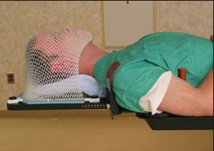


Personalized Immobilization Devices
Goals = comfort and reproducibility

Slide 15
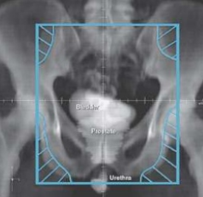
CT Based 3D-Treatment Planning
Enables more accurate delineation of target and normal organs, with precise dose calculation for all structures
Older 2D Technique
Modern 3D Planning

Slide 16
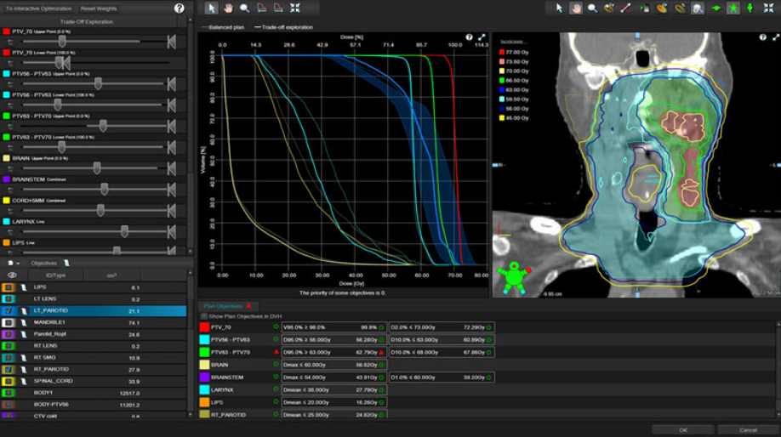
Generating a Radiation Treatment Plan
Performed by a dosimetrist or medical physicist
Sophisticated computer software enables adjustment of a variety of parameters to optimally achieve planning objectives

Slide 17
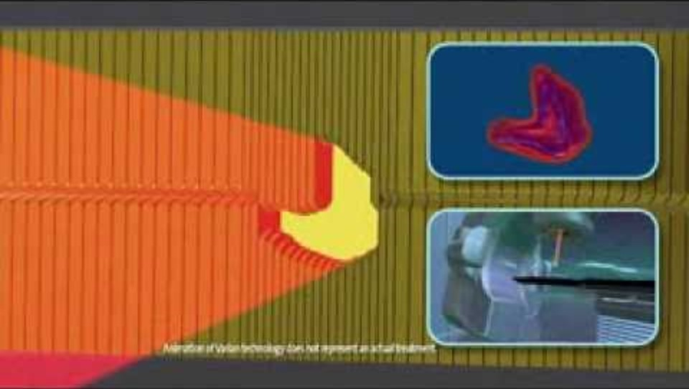
Dose is Shaped Around Curved Targets

Slide 18
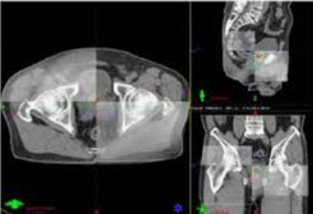
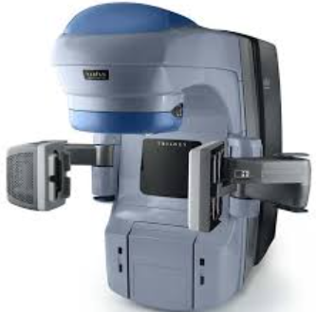
Image-Guided Treatment Delivery
Accounts for daily shifts in soft tissue anatomy or patient setup
Enables reduced treatment margin around tumor → less toxicity

Slide 19
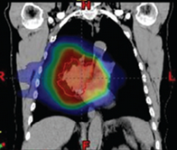
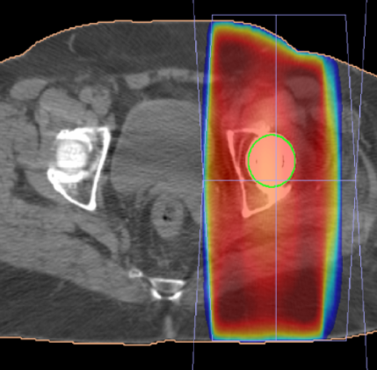
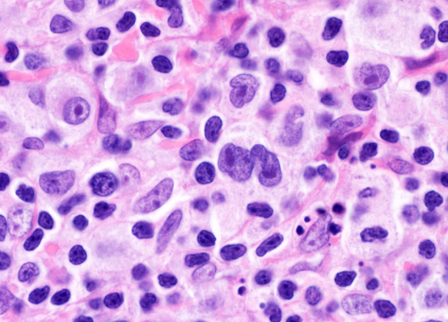
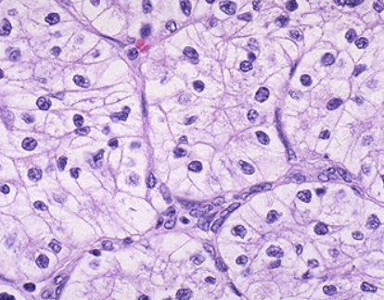
Radiation Dose Prescription
Gray (Gy) is the unit of RT dose
1 Gy = 100 centiGray (cGy)
1 cGy roughly equals dose from 1 CT scan
Dose prescription depends on:
Goal of treatment (curative > palliative)
Amount of disease (gross > microscopic)
RT sensitivity of tumor
RT sensitivity of surrounding normal tissue
Notes:
For example, when treating with curative intent, as in the lung tumor, we might give 60 Gy, whereas the palliative treatment for a bone metastasis may only by 20 Gy.
For example, the lymphoma on the left is much more sensitive to radiation than the clear cell RCC on the right.

Slide 20


Radiation Dose Fractionation
The total dose is delivered in fractions (not cycles)
Fractionation decreases risk of toxicity by allowing for DNA repair in normal tissue
The potency, or Biologically Effective Dose of a RT course depends not only on total dose, but how that dose if fractionated, and the tissue irradiated.

Slide 21
Palliative Treatment Techniques
Conventional Palliative RT
Simple, low tech, low cost
(planning takes < 1 day)
Very commonly used for symptom relief of radiosensitive tumors
Less conformal dose (in some cases can increase acute toxicity)
Lower BED (minimal risk of late toxicity, but lower long-term local control, slower symptom relief)
- e.g. 8Gy/1fx, 20Gy/5fx, 30Gy/10fx
SBRT/SABR
More complex, high tech, higher cost
(planning takes 3-7 days)
Indicated for symptom relief for radioresistant tumors, or for local control of oligometastatic tumors
Highly conformal dose
(minimal acute toxicity)
Higher BED (more rapid symptom relief and better long-term local control, but can increase risk of late toxicity)
- e.g. 18Gy/1fx, 30Gy/3fx, 40Gy/5fx

Slide 22
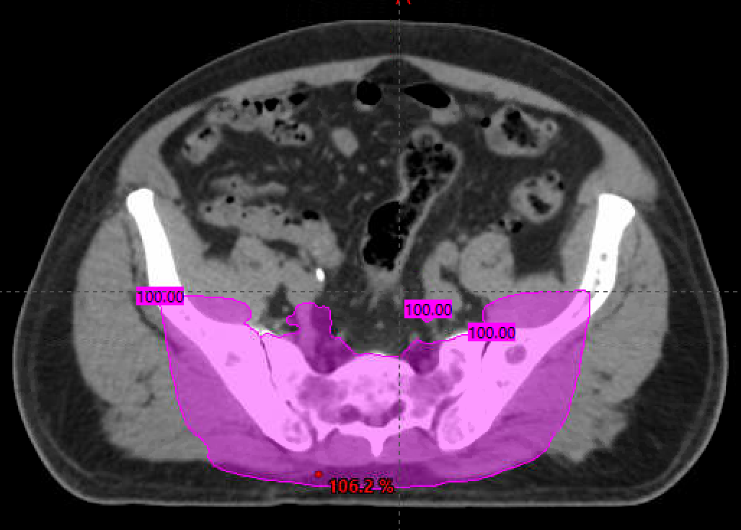
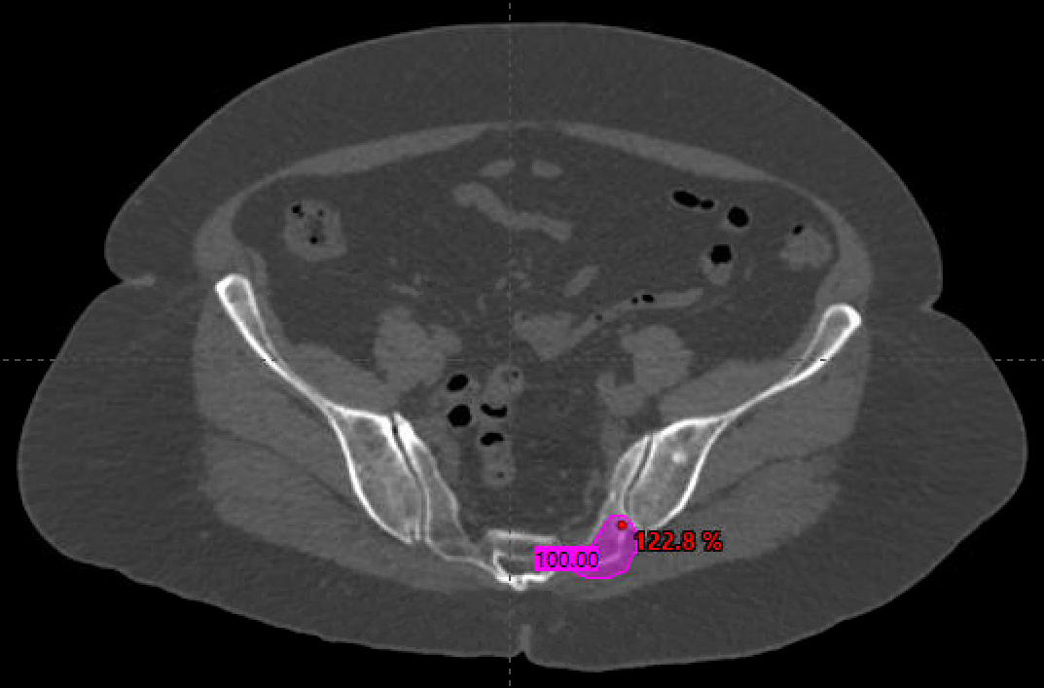
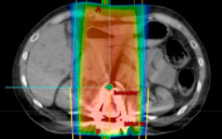
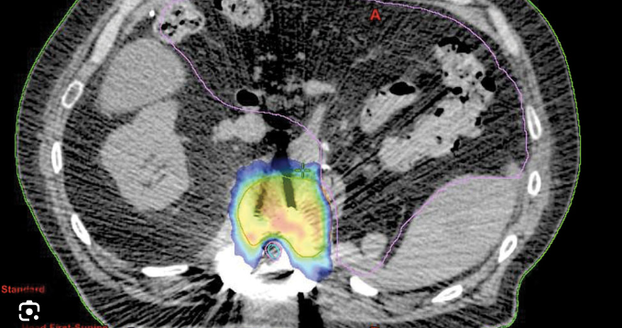
Conventional RT vs. SBRT for Bone Mets
Conventional 2-3 Field Plan
SABR/SBRT

Slide 23
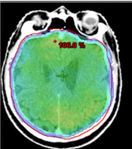
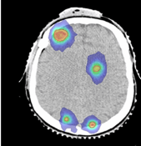
Conventional RT vs. SRS for Brain Mets
Whole Brain RT
SRS/SRT

Slide 24
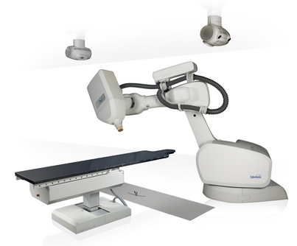
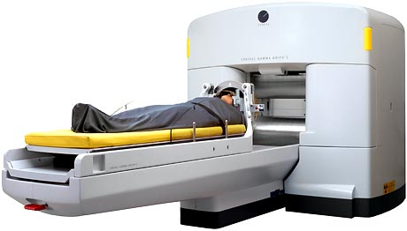
Specialized Treatment Platforms for Stereotactic Radiosurgery

Slide 25
Common Indications for Palliative RT
 | Examples | Time to Response
Bleeding | Bladder, GYN, lung, etc. | days
Obstruction | SVC, airway, esophagus, ureter, bile ducts | days - weeks
Pain | Bone mets, neuropathic pain | days - weeks
Neurologic Symptoms | Cord compression, brain mets | days - weeks
Since time to response is not immediate, we can get ahead of issues (and avoid emergencies) with earlier consultations.
A general rule of thumb is that ~75% of patients who live long enough to respond to palliative RT will have improvement in their symptoms (though in practice, a number of factors can affect this rate).

Slide 26
Radiation is the Central Modality for Most Physical Symptom Management
All cancer symptoms exist on a spectrum
Mild symptoms
Relatively controlled
Moderate symptoms
Impacting quality of life
Severe/life threatening symptoms or refractory to other treatments
Immediate relief needed
Systemic Therapy Alone
no local side effects, but response less likely and often delayed
+ Radiation Therapy
mild-mod potential for short- or long-term local side effects
+ Surgery/Invasive Procedure
higher potential for short- or long-term local side effects
Before any intervention, goals of care should always be evaluated, and hospice considered, depending on patient’s values and wishes

Slide 27
Medical Management of Symptoms During or After Palliative RT
Symptom relief is often gradual
ongoing medical management of symptoms, and support from other involved physicians, is helpful.
Communication between services for titration of opioids, steroids, AEDs, etc

Slide 28
Differentiating Palliative RT Indications from Curative RT Toxicities
The same symptoms that radiation can effectively alleviate, it can also cause as late toxicity after high dose curative treatments.
e.g. bleeding from RT proctitis vs. rectal cancer
e.g. dyspnea from RT fibrosis vs. lung cancer
This does not mean that radiation will make a cancer-induced symptom worse.
Most tumors respond to RT.

Slide 29
Risk of Toxicity from Palliative RT
Depends on RT dose, treatment technique, and normal organs in proximity to site of treatment
Short-term (acute) toxicity is generally mild and readily controlled with supportive medications. Examples:
A few days of dysphagia after T-spine conventional RT
Nausea from L-spine radiation
Long-term (late) toxicity is generally uncommon, with some exceptions:
Neurocognitive side effects from whole brain RT
Compression fractures from spine SBRT
The risk:benefit ratio of palliative RT should always be carefully weighed, but generally favors treatment due to the worse symptoms from unchecked tumor growth

Slide 30
How Should Radiation Toxicity Be Managed?
The cause of toxicity in oncology are often multifactorial, and commonly misclassified. Multidisciplinary involvement will lead to the most accurate diagnosis and best management.
Anytime radiation-induced toxicity is suspected, it is best to discuss with the radiation oncologist.
Knowledge of RT toxicity risk based on dose delivered, tissue irradiated, and time course since RT.
Trained in appropriate management of RT toxicity.

Slide 31
Triaging Patients for Palliative Radiation Therapy
WARNING: This may be a fundamentally different approach than what you are accustomed to.

Slide 32
Why A Team Based Approach to Palliation
Oncology education is siloed
Limited required GME cross-training
Not all knowledge is shared
Physiology/pharmacology
Anatomy/locoregional therapies
Risks/benefits of each Tx modality
Prognostic assessment/Optimism bias
Each offers unique expertise and perspective that benefits the team
Overlapping Knowledge Of Physicians Who Care for Patients with Metastatic Cancer
Palliative Care
Medical Oncology
Radiation Oncology
Effective teamwork → higher quality, patient-centered care
Surgeon or Other Procedure-Oriented Subspecialist

Slide 33
Suboptimal Timing of Radiation Oncology Consults
¹A survey of a multi-institutional cohort of 28 radiation oncologists with expertise in palliative care suggested:
Referrals for palliative RT were perceived as being inappropriately delayed 47% of time at their institution.
Most common reasons: Lack of knowledge, concern for interference with systemic therapy, concern for patient convenience
¹Parker et al., Ann Pall Med, 2019

Slide 34
The Most Common (but Suboptimal) Care Path
Surgeon or other procedure-oriented specialist
often consulted first (single decision-maker model)
Three potential outcomes
Appropriate decision to proceed with invasive procedure
Decision not to proceed with procedure, but subsequent delay in referral to appropriate service
Inappropriate and/or overaggressive use of invasive procedures (often due to incomplete understanding of options)

Slide 35
The Optimal Patient-Centered Care Path
Concurrent referral to surgical, medical, palliative and radiation oncology teams (multiple decision-maker model)
Expedited workup
Multidisciplinary discussion and consensus
Expedited initiation of appropriate treatment
More rapid hospital discharge (or avoid admission)
The Bottom Line: Doctors working collaboratively are more likely to take timely and appropriate actions.

Slide 36
Value of Multidisciplinary Inpatient Care that Includes Radiation Oncologists
¹Observational cohort study of 181 patients with painful bone metastases. The use of a dedicated palliative rad onc consult service that worked closely with other specialties led to:
Shorter hospitalizations by an average of 8 days
Cost savings of $20,719/patient/hospitalization
35% increase in palliative care specialty utilization
¹Chang et al, J Pain Symptom Manage., 2018

Slide 37
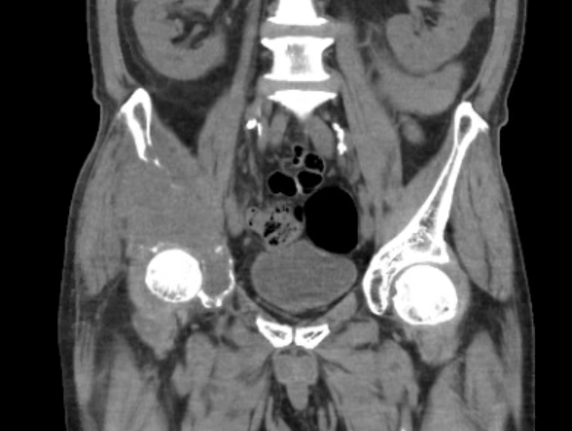
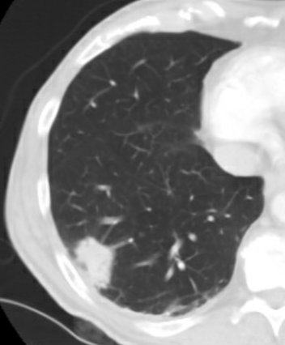
Case #1: Bone Metastasis
69M former smoker with no prior cancer history presents to ED with right hip pain and limp.
Who should you consult?
What should you do for his pain?
Notes:
(after 1st bullet) → Imaging shows a large destructive mass in the right hip, wrapping around the acetabulum, as well as a lung mass.
(after 2nd bullet) → Med Onc, Rad Onc, Orthopedic Surgery simultaneously → decide together what to biopsy and how to best manage his pain in this patient with a very high likelihood of malignancy based on imaging
(after 3rd bullet) → There typically aren’t great surgical options for something as extensive as this in the pelvic bones, and so the standard treatment would be palliative RT followed by systemic therapy for his metastatic disease. Unfortunately, what actually happened with this patient was that the ED only consulted the orthopedic surgery team. They thought they might take the patient to the OR, and ordered a pre-op embolization, which only made the pain worse. They then realized they couldn’t operate on this, aborted the surgery, and decided to throw the kitchen sink at him. They consulted rad onc for palliative RT and IR to perform an ablation procedure. Ablation may sometimes be used as a second line treatment for bone metastases, but was unlikely to work in this case given the size and shape of this tumor. IR performed the ablation, and the patient had no benefit. Finally radiation was started after a 1 week delay for all of these other unnecessary procedures. Once radiation was started, his pain gradually improved and he was relatively pain free for the rest of his life until he ultimately died of progressive systemic disease 12 months later.

Slide 38
When to Consult Radiation Oncology?
Immediately upon diagnosis of any cancer-related symptom that may benefit from radiation, and concurrently with medical and surgical teams.

Slide 39
Who Can Consult Radiation Oncology?
Anyone! Inpatient consults from internal medicine/hospitalists, emergency medicine, palliative care, etc are welcome if those services are caring for a symptomatic inpatient with cancer.
For patients with metastatic disease, medical oncology should be involved in consultation decisions since they are often most involved in outpatient care.
A consultation is just a request for an opinion. It does not mean a patient will necessarily be treated.
Patients benefit from multidisciplinary input. Don’t be shy!

Slide 40
Is Pathology Required Prior to Consult?
No! If cancer is suspected on exam or imaging, and a patient is symptomatic, DO NOT wait for biopsy to be completed, or pathology resulted, for the consultation.
Usually, radiation oncologists will wait for pathologic confirmation of malignancy to initiate radiation therapy, but not always.
Radiation oncologists can help ensure the right diagnostic tests are being ordered, and initiate RT treatment planning (which takes time), and can occur while waiting for pathology results

Slide 41
Can Anyone Not be Irradiated?
Patients usually must be able to lie flat on treatment table
Can be an issue if in significant pain or shortness of breath; medical optimization can overcome this issue.
Patients must be cooperative
Can be an issue with altered mental status or children; can consider sedation or anesthesia support if indicated.
Brain or head/neck tumors usually require a head mask
Can be an issue if claustrophobic; sometimes anxiolytic medications can overcome this issue.

Slide 42
Patients Near the End of Life
It is always better to give palliative RT while a patient has a long enough life expectancy to benefit from it.
There are some patients approaching the end of life who may benefit from a single fraction of palliative RT before hospice enrollment.
Need to consider patient’s life expectancy on hospice to determine if palliative RT right before enrollment is likely to benefit them.
Hospice services generally will not pay for radiation therapy (with some exceptions), so better to do that single treatment before enrollment.
It is okay to discontinue a course of palliative RT for a patient to go on hospice, but the radiation oncologist should be involved in that decision.

Slide 43
Palliative RT for Patients On Clinical Trials
Many pharmaceutical trials for metastatic cancer do not allow palliative RT or other cancer treatments while a patient is enrolled, since it can complicate systemic response assessment.
If a patient develops worsening symptoms, it likely indicates disease progression and should be evaluated. All standard of care treatment options should be discussed.
Usually palliative RT would be avoided until the patient goes off study, however, patients may withdraw from trials at any time if they choose to pursue another treatment that is not permitted on the trial.

Slide 44
Case Studies in Effective Multidisciplinary Care

Slide 45
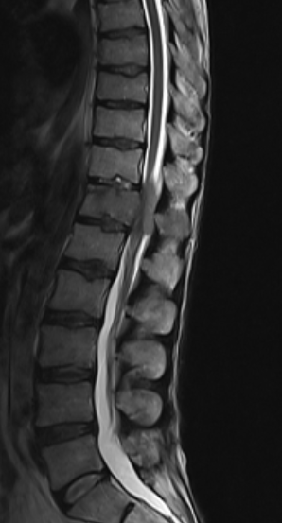
Case #2: Spinal Cord Compression
57F with known metastatic breast cancer who presents with progressively worsening back pain over the past month and new left lower extremity weakness for the past two days.
MRI of the full spine shows a T12 vertebral body metastasis with epidural compression.
Decadron is started to reduce edema.
Neurosurgery, medical oncology and radiation oncology are consulted. After discussion, a decision is made to proceed with surgical decompression.

Slide 46
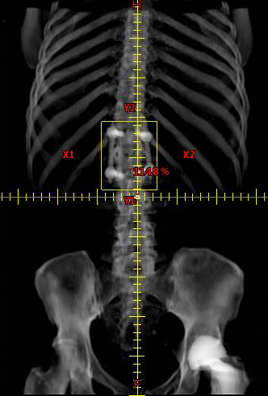
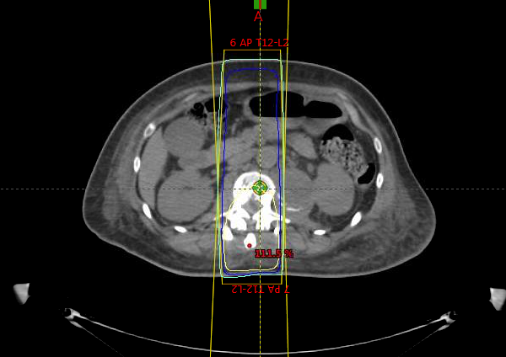
Case #2: Spinal Cord Compression
Radiation therapy is initiated on post-op day 10.
How would management change if this was multiple myeloma? Or lymphoma?
What if life expectancy was less than three months?
Notes:
(after 1st bullet) → However, this case may have been treated very differently if a few factors were changed.
(after 2nd bullet) → Chemosensitive and radiosensitive tumors often do not need surgery unless there is considerable mechanical instability that needs stabilization. Hematologic malignancies causing ESCC are often managed with chemotherapy alone.
(after 3rd bullet) → If life expectancy is less than 3 months, you typically wouldn’t do surgery given the risks in a patient with poor functional status, and would proceed with radiation. If the prognosis is very poor, or the patient plans to go on hospice, 8 Gy x1 may have been used instead of a 5 or 10 fraction course. Having a full team involved in talking through these issues can help patients towards the best outcome possible.

Slide 47
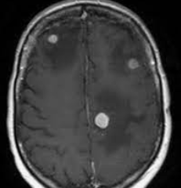
Case #3: Brain Metastasis
62M with a history of metastatic NSCLC currently on immunotherapy, who comes to the ED complaining of headache, nausea and vomiting. MRI brain shows three enhancing lesions with surrounding vasogenic edema.
Who should you consult?
What should you do for his symptoms?​
What are his treatment options? Would they differ if there are 15 lesions? Or a dominant 4cm lesion causing most of his symptoms?
Notes:
(after 2nd bullet) → Neurosurgery, radiation oncology, and medical oncology should be consulted, so they can discuss optimal treatment approach in the context of his life expectancy.
(after 3rd bullet) → Decadron will help with his symptoms.
(questions in 4th bullet) → Surgery will have little role given that there are multiple lesions and all are small. The patient should be given steroids for his symptoms, and if stable enough he should be discharged and set up for outpatient stereotactic radiosurgery, which would be preferred given the limited number of small lesions. Whole brain radiation becomes the preferred option if more brain metastases are present, at the expense of long term neurocognitive toxicity. If a dominant lesion is present, surgical resection of it would be useful for immediate symptom relief, even in some cases when multiple brain metastases are present.

Slide 48
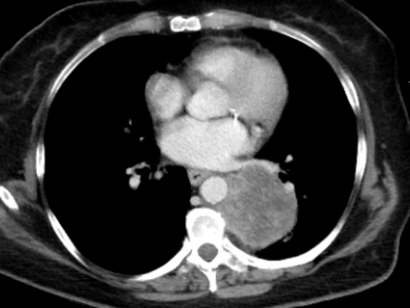
Case #4: Lung Mass with Mediastinal Invasion
64F active smoker with HIV is admitted for peritoneal abscess.
CT abdomen/pelvis shows a LLL lung mass as an incidental finding.
What should you do?
Notes:
(after 3rd bullet) → Given the smoking history, this is highly likely to be malignancy. Although it is not symptomatic now, it is invading the mediastinum and wrapping around the aorta, so expedited workup with inpatient imaging and CT-guided biopsy is appropriate. Thoracic surgery, medical oncology, and radiation oncology should be consulted.

Slide 49
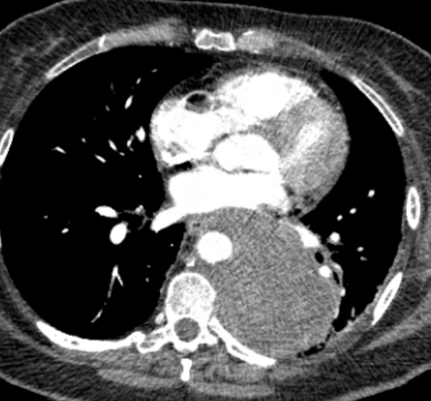
Case #4: Lung Mass with Mediastinal Invasion
The thoracic surgery team alone was consulted, but asked that the patient just follow-up as outpatient with no further inpatient workup.
There was a six week delay in the patient’s care, when she returned to the ED with severe back pain and progressive disease on imaging.
Biopsy showed NSCLC.
Notes:
(after 2nd bullet) → you can see now that the mass has further invaded the mediastinum with loss of fat planes between the tumor and the esophagus and aorta

Slide 50
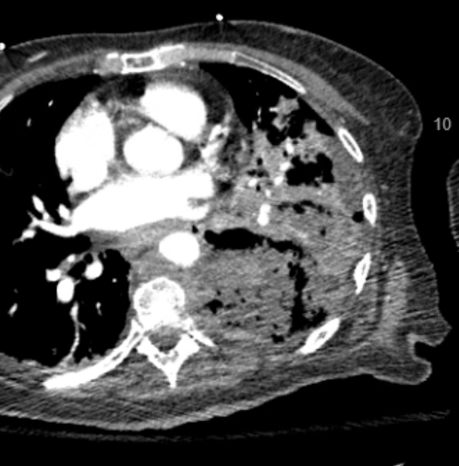
Case #4: Lung Mass with Mediastinal Invasion
Radiation oncology was eventually consulted, and the patient started chemo-RT, with excellent response over first two weeks of treatment.
Unfortunately, regression of mass opened a fistula with bronchus or esophagus, and she died soon after.
She is unlikely to have had this complication if multidisciplinary referrals were initiated sooner.

Slide 51

Take-Home Points
Palliative radiation therapy is typically a short-course, non-invasive, treatment that is highly effective at relieving symptoms, and infrequently causes severe toxicity.
Radiation oncologists have expertise in multidisciplinary local symptom management, and are the most knowledgeable physicians about RT indications and RT toxicity.

Slide 52

Take-Home Points
Any patient with cancer-induced symptoms should have a radiation oncology consultation concurrently with the rest of the multidisciplinary cancer team.
If you’ve never done so, consider spending a day in radiation oncology to get a better sense of what we do.

Slide 53

Thank You!
Please take five minutes to answer the questions in this electronic survey.
https://redcap.link/palliative_post

